Slide 1
Mutant Tests Too: The SQL
Strata, London 2019 Elliot West, Jay Green-Stevens
2/May/2019

Slide 2
SQL SQL SQL SQL SQL SQL
SQL SQL SQL SQL SQL SQ L SQL SQL SQL SQL SQL S
QL SQL SQL SQL SQL SQL
SQL SQL SQL SQL SQL SQL
SQL SQL TESTS?? SQL SQ L SQL SQL SQL SQL SQL S
QL SQL SQL SQL SQL SQL
SQL SQL SQL SQL SQL SQL
SQL SQL SQL SQL SQL SQ
L SQL SQL SQL SQL SQL S
Notes:
Java/Cascading
Modular
Automated testing
SQL
Manual testing
Long cycle times

Slide 3
Notes:
Accessible
Powerful
Widely taught

Slide 4
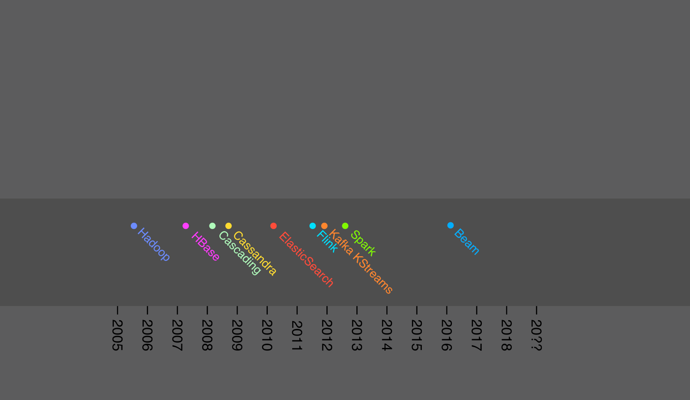
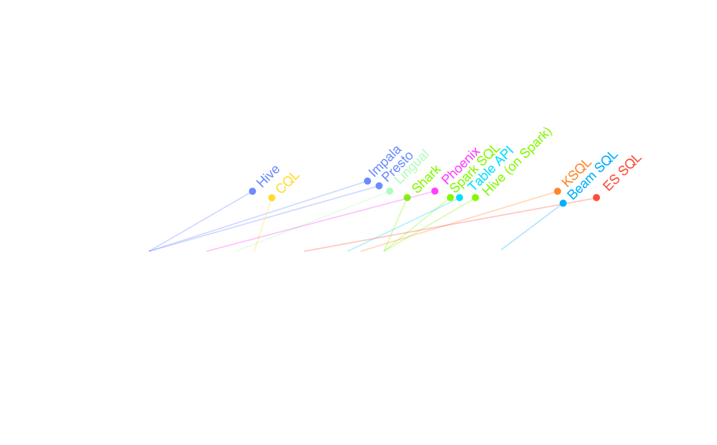
45 years on: Is SQL still relevant?
SQL
release(s)
Platform
release
Notes:
Innovation in data processing space
Hadoop changes everything
Higher levels of abstraction
Streaming
SQL follows
As recently as Beam
Cloud services also

Slide 5
Our vision
Any process that alters or interprets data should be tested!
Unit tests are the first defence
Hours of test development saves days of data clean-up
Notes:
Unit tests empower developers in the testing process
Hours spent writing tests saves days cleaning up erroneous data

Slide 6
Unit testing SQL: Challenges
Unit test culture + tools not as strong
Monolithic scripts difficult to reason about
No visibility on test coverage or quality

Slide 7
Code coverage

Slide 8
Unit testing SQL: Focus areas
Improve the following:
Unit testing frameworks
HiveRunner
SQL modularisation patterns
Code coverage
MutantSwarm

Slide 9
HiveRunner overview
Open source unit test framework for Hive SQL
https://github.com/klarna/HiveRunner
Local execution (Laptop/CI servers)
Test cases defined in Java + Hive SQL
Based on JUnit 4

Slide 10
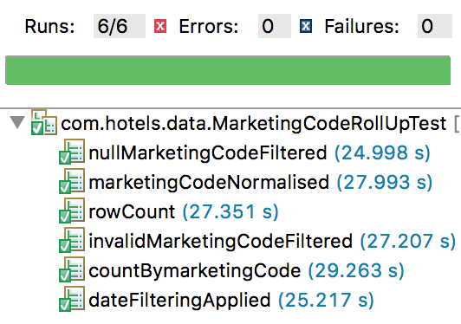
Framework: HiveRunner
SQL
Setup
SQL
Under Test
HiveRunner
User Test Suite
Test
Reports

Slide 11
THOUGHTWORKS TECHNOLOGY RADAR
HiveRunner
TRIAL
LANGUAGES &
FRAMEWORKS
HiveRunner is an open-source unit test framework for Apache Hadoop Hive queries based on JUnit4. When writing nontrivial analytics or data pipelines in Hive SQL, we found HiveRunner to be a good enabler for writing tests and even TDDing out some moderately complicated SQL. HiveRunner enables you to write Hive SQL as releasable tested artifacts.
Source: https://www.thoughtworks.com/radar/languages-and-frameworks/hiverunner

Slide 12
Monolithic queries
SELECT ... FROM (
SELECT ... FROM (
SELECT ... FROM (
SELECT ... FROM a WHERE ...
) A LEFT JOIN (
SELECT ... FROM b
) B ON (...)
) ab FULL OUTER JOIN (
SELECT ... FROM c WHERE ...
) C ON (...)
) abc LEFT JOIN (
SELECT ... FROM d WHERE ...
) D ON (...)
GROUP BY ...;
-- Query 1
-- Query 2
-- Query 3
-- Query 4
-- Query 3
-- Query 5
-- Query 3
-- Query 2
-- Query 6
-- Query 2
-- Query 1
-- Query 7
-- Query 1
-- Query 1
Notes:
Easy to write
Difficult to maintain
Hard to test
Would like to decompose
into units!
Modularise with Hive…
How?

Slide 13
Approaches
Chained tables
Views
Variable substitution
HPL/SQL
Notes:
Chained tables – common pattern in our team
Belief that views have adverse performance impact

Slide 14
Chained Tables
query.sql
inner.sql
SOURCE inner.sql;
INSERT OVERWRITE TABLE x AS SELECT …
FROM (
) …
INSERT OVERWRITE TABLE
inner AS
SELECT upper(a), b, …
FROM source
…
SELECT upper(a), b, …
FROM source
…
SELECT *
FROM inner
Q1
Q2

Slide 15
Chained Tables
source1
X | Y
… | …
temp1
X | Y
… | …
Q2
Q4
temp3
X | Y
… | …
result
X | Y
… | …
Q1
source2
X | Y
… | …
Q3
Well understood
Can view intermediate results
I/O between stages
Query optimisation limited

Slide 16
Variable substitution
query.sql
inner.sql
SET inner = <inner contents>;
INSERT OVERWRITE TABLE x AS SELECT …
FROM (
) …
SELECT upper(a), b, …
FROM source
…
SELECT upper(a), b, …
FROM source
…
${inner}
S1
S2

Slide 17
Variable substitution
S1
+
S2
=
Q1
source1
X | Y
… | …
result
X | Y
… | …
source2
X | Y
… | …
Requires assembly
Not ’pure SQL’

Slide 18
Nested Views
x.sql
inner.sql
SOURCE inner.sql;
INSERT OVERWRITE TABLE x AS SELECT …
FROM (
) …
CREATE VIEW inner AS
SELECT upper(a), b, …
FROM source
…
SELECT *
FROM inner
SELECT upper(a), b, …
FROM source
…

Slide 19
Nested Views
Q1
V1
source1
X | Y
… | …
result
X | Y
… | …
source2
X | Y
… | …
Greater scope for optimisation
Poor parameterisation handling

Slide 20
Testing: Job counts
Queries: 3
Nesting depth: 2
Aggregations: 1
Sorts: 1
Notes:
Query plan
Number of jobs – rough estimation of work/overheads

Slide 21
Testing: Execution time
EMR cluster
100GB data input
Multiple iterations
Notes:
All very similar
Takeaways
You can use any
Views don’t seems to adversely impact

Slide 22
Further details
https://medium.com/hotels-com-technology/modularising-hive-queries-dff90f85f7d6
https://cwiki.apache.org/confluence/display/Hive/Unit+Testing+Hive+SQL

Slide 23
Mutant Swarm

Slide 24
Code coverage tools
Java has awesome code coverage and reporting tools
Cobertura, Jacoco, PIT
Highlights weaknesses in tests
Motivates developers to write more tests
Fast feedback
Can we have this for SQL?

Slide 25
What is Mutation testing?
Used to design new software tests and evaluate quality of existing software tests
Involves modifying a program in small ways (mutants)
Test suites are measured by the % of mutants killed
New tests designed to kill additional mutants
SQL coverage/mutation testing prior art (University of Oviedo):
https://in2test.lsi.uniovi.es/sqltools/sqlrules/

Slide 26
Example SQL test
TEST DATA
SOURCE UNDER TEST
RESULT
hotels
ID | NAME | PRICE
1 | AC Hotel | 150
2 | Princess | 200
3 | Motel X | 60
NAME | PRICE
princess | 200
ac hotel | 150
SELECT lower(name), price
FROM hotels
WHERE price > 100
ORDER BY price DESC
LIMIT 5
TEST SUITE
Assert size == 2
Assert result[0] == ‘princess’
Assert result[1] == ‘ac hotel’

Slide 27
Mutating SQL
Genes
Mutations
FN: lower
upper
Sequencing
null
name
COL: price
SELECT lower(name), price
FROM hotels
WHERE price > 100
ORDER BY price DESC
LIMIT 5
<, =
<>
OP: >
SORT: DESC
ASC
1
10
VAL: 5

Slide 28
Mutant survivors/victims
SELECT lower(name), price
FROM hotels
WHERE price > 100
ORDER BY price DESC
LIMIT 5
SELECT upper(name), price
FROM hotels
WHERE price > 100
ORDER BY price DESC
LIMIT 5
SELECT lower(name), null
FROM hotels
WHERE price > 100
ORDER BY price DESC
LIMIT 5
╳
✓
SELECT lower(name), price
FROM hotels
WHERE price < 100
ORDER BY price DESC
LIMIT 5
SELECT lower(name), price
FROM hotels
WHERE price = 100
ORDER BY price DESC
LIMIT 5
SELECT lower(name), price
FROM hotels
WHERE price > 100
ORDER BY price ASC
LIMIT 5
Column projection price not fully covered by test suite.
╳
╳
╳
ID | NAME | PRICE
1 | AC Hotel | 150
2 | Princess | 200
3 | Motel X | 60
TEST
Assert size == 2
Assert result[0] == ‘princess’
Assert result[1] == ‘ac hotel’

Slide 29
Gaps versus weaknesses
SELECT lower(name), null
FROM hotels
WHERE price > 100
ORDER BY price DESC
LIMIT 5
✓
Survivors can suggest a gap in tests
However, perhaps price was expected to be null?
Suggests that more tests and discriminating test data is required

Slide 30
Mutant Swarm: How it works
Run tests for each mutant
Mutation report
Sequence SQL genes
Mutant SQL
Under Test
Run tests + report
Generate mutants
Mutant SQL
Under Test
SQL
Setup
SQL
Under Test
Mutant SQL
Under Test
HiveRunner
User Test Suite
Mutant Gene DB + Sequencer
Test
Reports
Mutation
Reports

Slide 32
Challenges
Execution performance
HiveRunner is not the fastest
Solutions?
Run tests in parallel
Mutate only changed code sections
Improve HiveRunner performance
t_{MS} ∝ t_{HR} × genes × mutations

Slide 33
Summary
Created a toolkit to facilitate:
Increased test development, of a higher quality
Data quality improvement by identifying errors
Unit testing, modularisation, test coverage
Future work: Improve:
Execution performance
Mutation types (greater coverage of SQL language)

Slide 34
github.com/HotelsDotCom/ mutant-swarm hive-runner-user@googlegroups.com linkedin.com/in/teabot linkedin.com/in/jay-greeeen

Slide 35
Thank you! Questions?

Slide 36
Unit testing SQL: Challenges
Unit test culture + tools not as strong
Monolithic scripts difficult to reason about
No visibility on test coverage or quality
case when ( ! (get_from_list(p4, '\\,', 0) LIKE '%<%') and length(get_from_list(get_from_list(p4, '\\,', 0), "\\;", 2)) > 0 )
then get_from_list(get_from_list(p4, '\\,', 0), "\\;", 2)
end as extract1,
case when ( ! (get_from_list(p4, '\\,', 0) LIKE '%<%') and length(get_from_list(get_from_list(p4, '\\,', 0), "\\;", 6)) > 0 )
then cast(get_from_list(get_from_list(p4, '\\,', 0), "\\;", 6) as BIGINT)
end as extract2

